Slide 1
IoT Farmbeats
By Team 28

Slide 2
User Requirements
Oscer Hao = Agricultural Research Scientist
Graduated from Royal Agricultural University, UK
1. What is your job like? What do you do?
As a Farm Research Scientist from the Biotechnology and Biological Sciences Research Council, I carry out fieldworks to gain insights to current farm processes. My goal is to optimize the process to increase crop yield for food sustainability. My research focuses on soil.
2. How do you collect the data? Do you have to travel directly to the farm to collect the data yourself?
Yes, I manually collect data, which is inconvenient since travelling from office to farm takes an hour every day. I place down the meters in the soil and take readings whilst I am at the farm to log data.
3. What kind of data will you be interested in having access to remotely?
I would love to have improved infrastructure on data collection method for factors such as soil pH, temperature and rainfall. I intend to use this to investigate the pollution level of the soil in order to help reduce its negative impact on plant growth from the soil.
4. In what form would you want data to be presented to help with your job?
A range of visualizations from which I can choose would be useful, for example pie charts and line graphs. I want to see how rainfall varies throughout the year and visualize relationships between factors that may affect the state of the soil over time.
5. What other features would you like to have in such a remote system?
Some pre-analysis of the data by trained models would help to predict costs, weather patterns, etc.
A model that can predict characteristics of soils such as nutrient and water level based off data already collected would be very useful.
We conducted phone-call interviews…
Farmer, Age 70
1. Do current normal farmers have any kind of remote way to monitor the situation of the farm? If yes, what's that, and do you find it easy for your life? If no, what's something that you would want if possible?
We do have some remote ways to monitor the farm such as cameras, but it's only used for monitor if there's any thief or animals that may damage the plants. We would want more devices that can monitor factors in the farm such as luminosity and temperature.
2. What's the level of software operating you got?
I have a smart mobile phone, but I only use it for WeChat and phone call, but my son can operate them quite well, I think.
3. How do you monitor and find out the situation of growth of plants in the farm?
Basically, what I used to do is to go down to the farm and see the situation by my hand and eyes.
4. How often do you monitor the situation in the farm?
At least once a day at morning.
5. What's the size of your field and how many time you would need to organize them everyday?
My land for wheat is half a MU, and there's also half a MU for corn, about quatre a MU for potato and other vegetables. (MU is a Chinese Unit of area, equal to 1/15 of a hectare or 1/6 an acre)

Slide 3
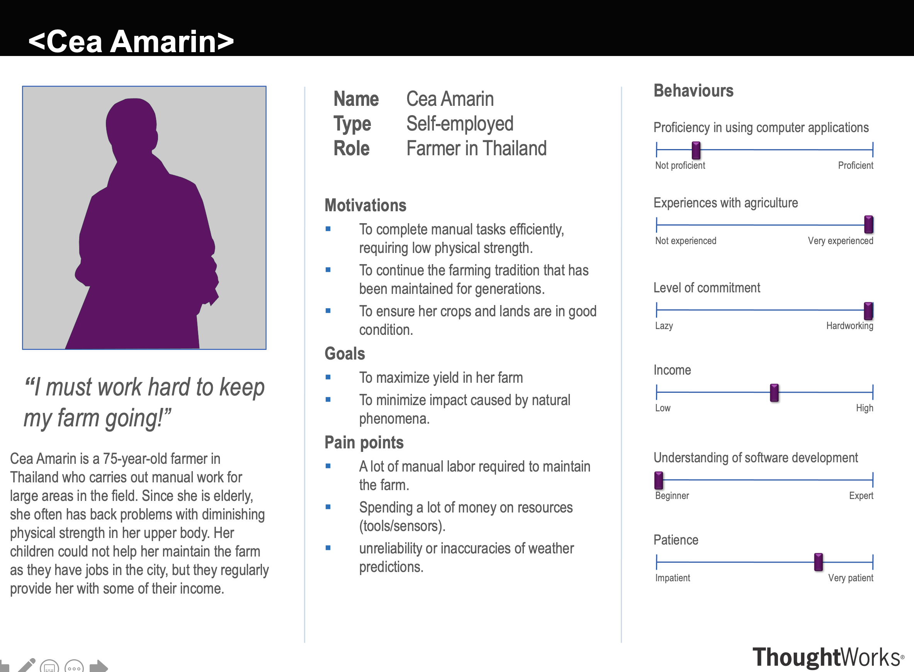
Persona and Scenario 1
Scenario
Cea is a 75-year-old farmer who is very experienced with agriculture. She wants to find a way to maintain the farm by herself, as she is elderly and finds herself lacking physical strength after a working for a long time. She mounted our devices to the farm and logged into our web-app to monitor the situation of the field. She monitors situations in the farm easily by seeing data and charts on the website. She also connects her original watering device into the system so she can finish daily job at home on her own. She is also able to determine the situation by the color of the indicator light on the web-app and follows suggestions given which are determined by our model. This makes her work life more convenient and simpler.

Slide 4
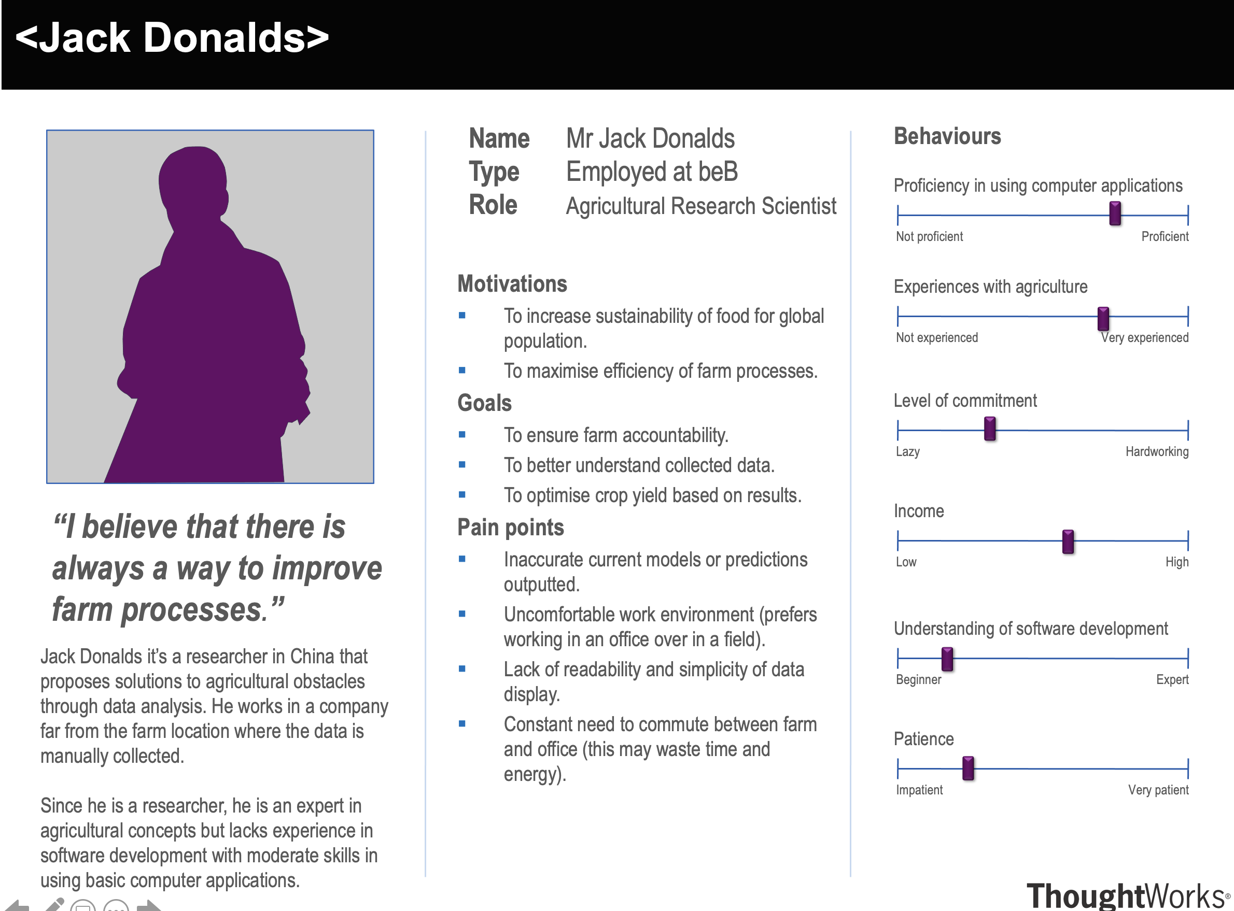
Persona and Scenario 2
Scenario
Jack Donalds is a 35-year-old agricultural researcher with and is quite experienced with using electronic devices and computer systems. He wants to collect some data on soil humidity and ambient temperature on the farm he is using as his case study. He accesses the farm's website on his computer, and briefly looks through all data shown on the first page to look for any anomalies. Satisfied that there aren't any error messages suggesting some problems, he clicks on the humidity sensor data, selects an option to display ambient temperature on the same graph. Satisfied with the data values, he downloads the data as an XML file and uses it for further analysis offline.

Slide 5
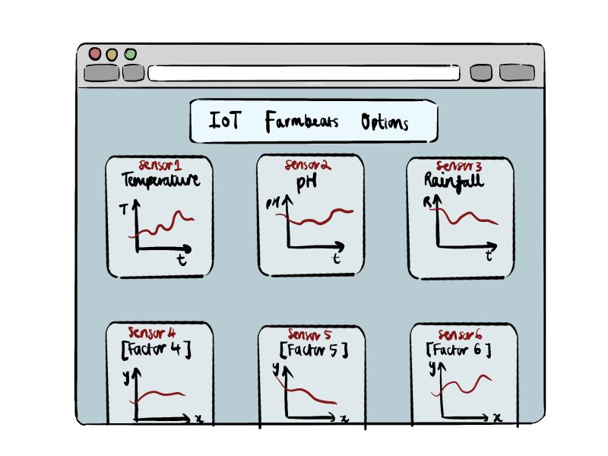
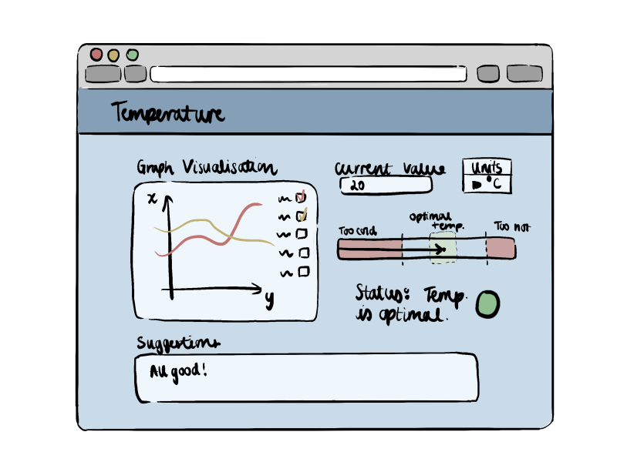
First Sketch

Slide 6
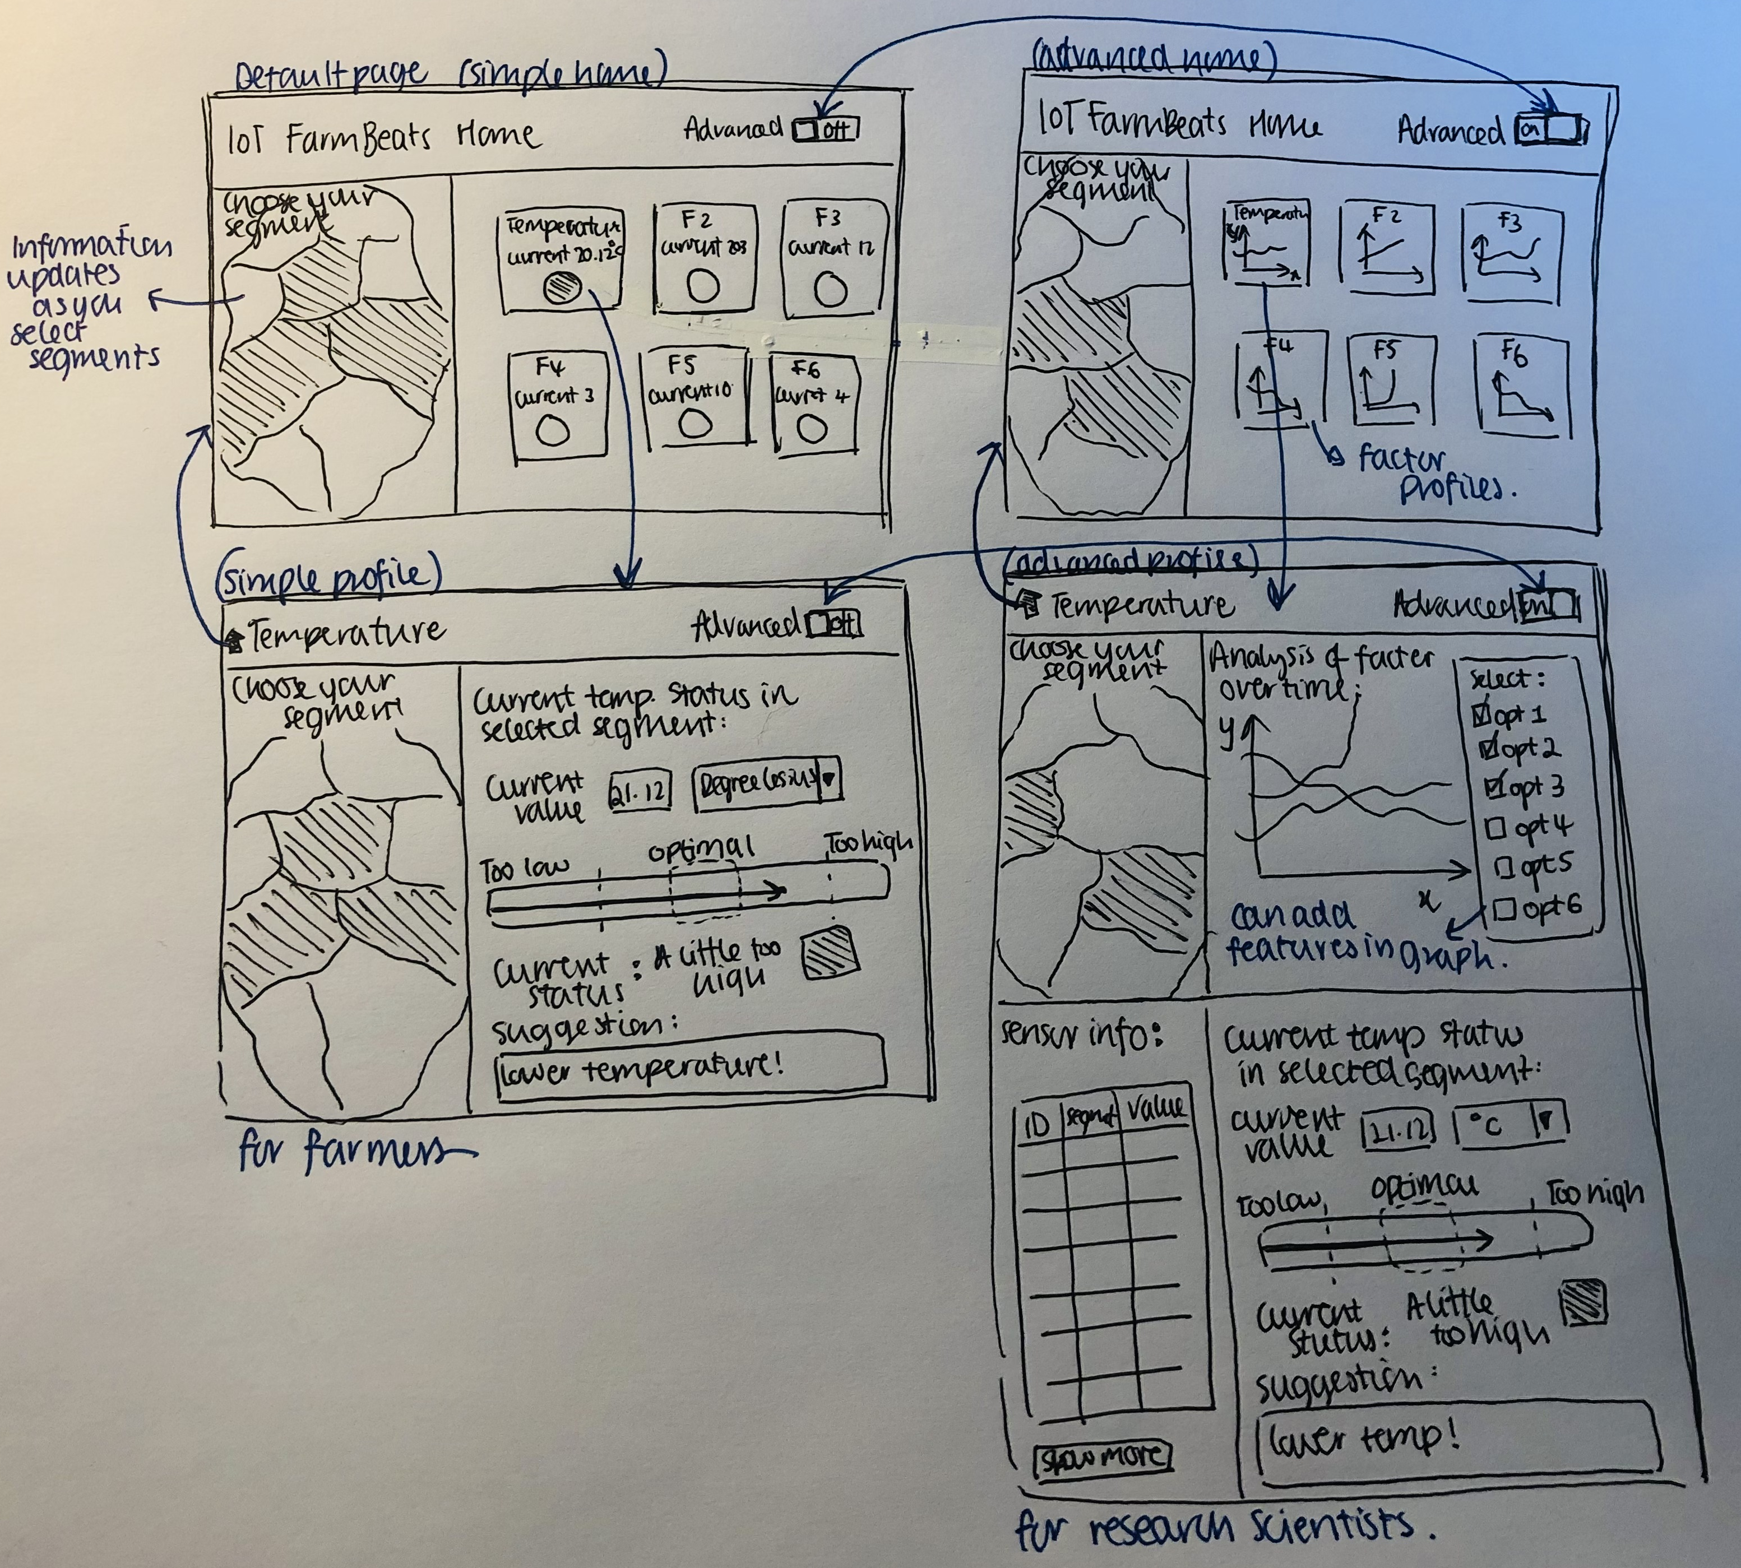
Review with Users and Second Sketch

Slide 7
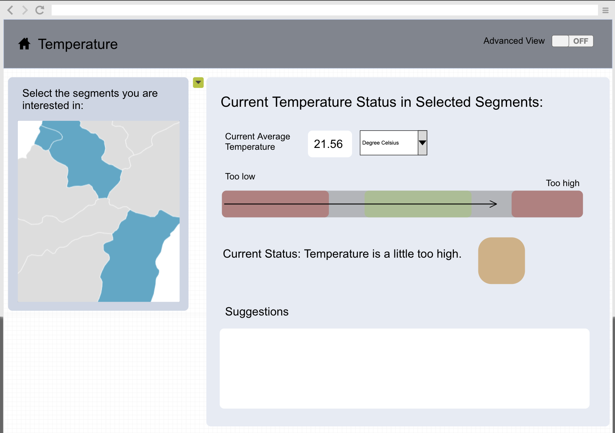
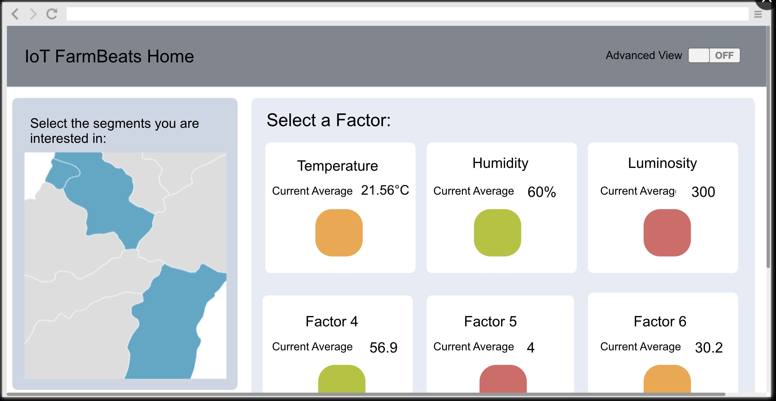
Prototype for Simple View
To profile page advanced view
To home page advanced view

Slide 8
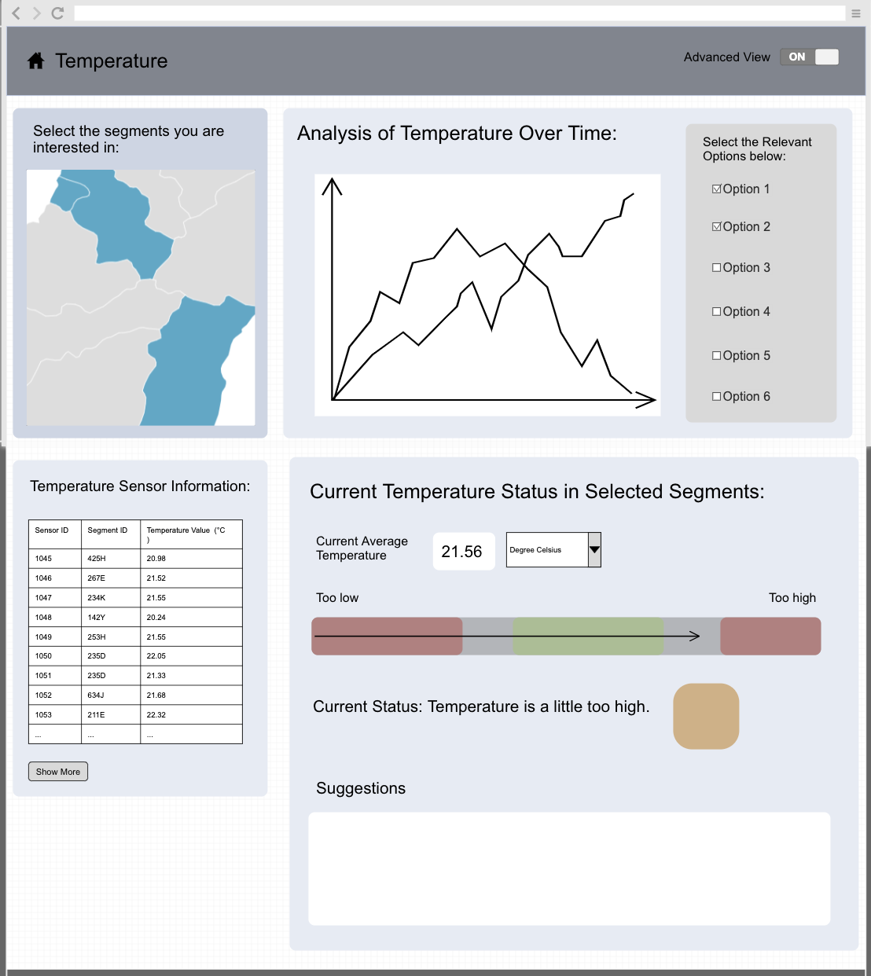
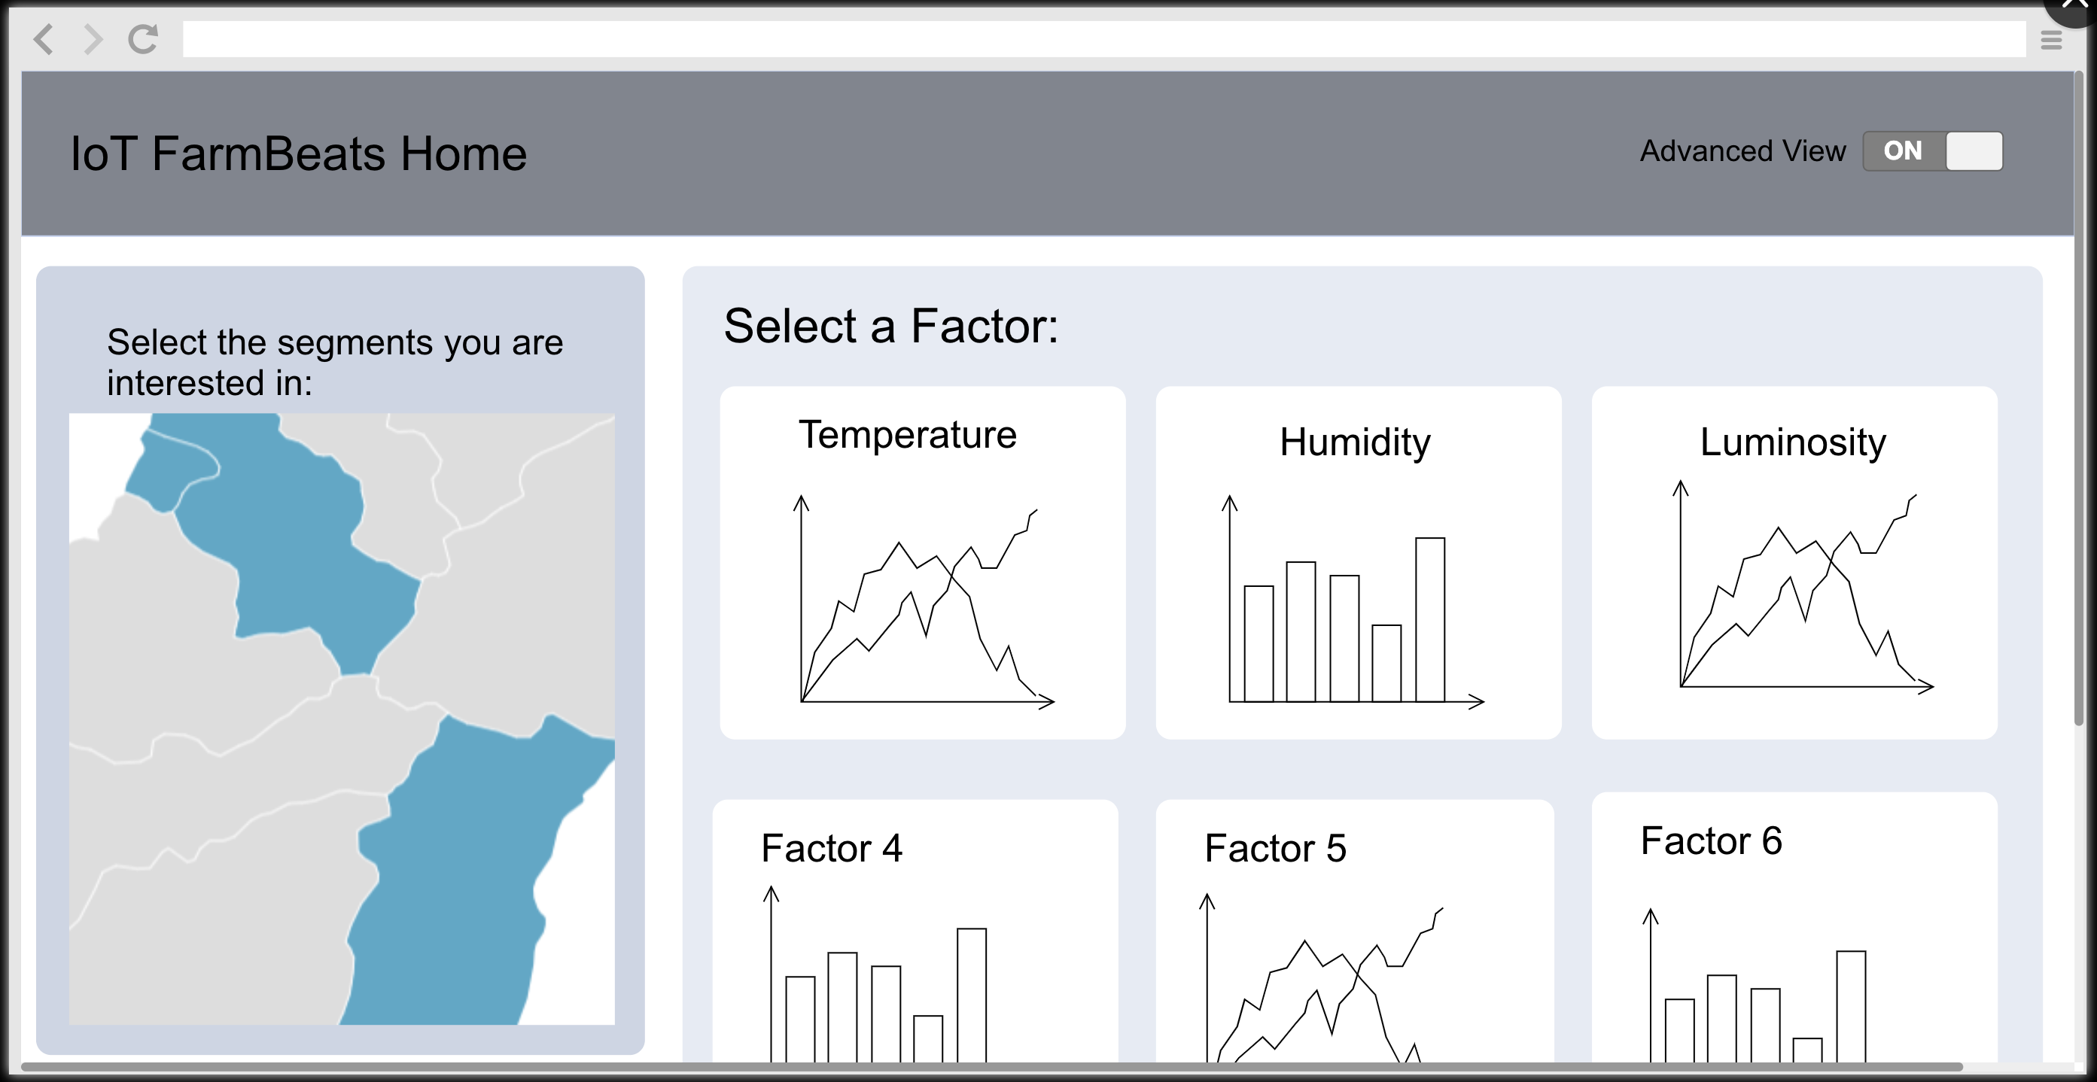
Prototype for Advanced View
To profile page simple view
To home page simple view

Slide 9
Evaluation and Improvements

Slide 10
References
https://www.environmentalscience.org/career/soil-and-plant-scientist
https://careerswales.gov.wales/job-information/agricultural-research-scientist/job-role

